Slide 1
Interactive Table for the Money Museum
Team Members:
Kien Chiem Victor Bissonnette Alfred Ledgin Saad Mansoor Anas Mourad Sami Shukri

Slide 2
Main Ideas
Interactive timeline displaying facts about the evolution of coins
Educate museum visitors about the history and ongoing development of currency in a way that is fun and engaging
Target audience of all age groups
Display the timeline and game on a four-screen table surface

Slide 3
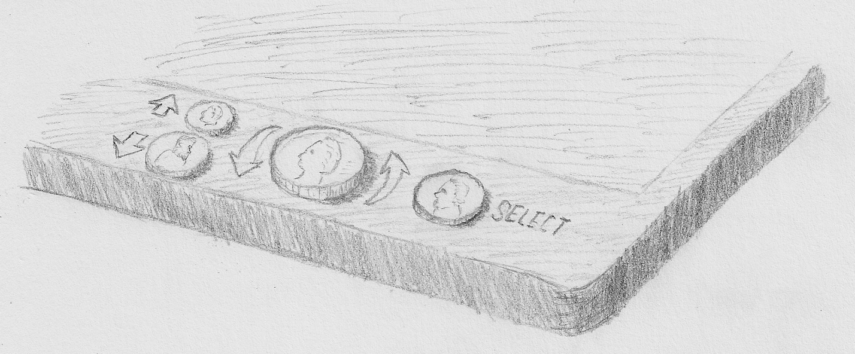
Ideas for the Display Unit
Use real buttons and a navigational dial to enhance subjective satisfaction and make the interface feel more game-like.
Each interface control is an enlarged, textured coin. All are in the relative sizes of the respective coins.
Quarter: Left-right navigational dial and “home” button
Nickel: Select button
Dime: Up button
Penny: Down button

Slide 4
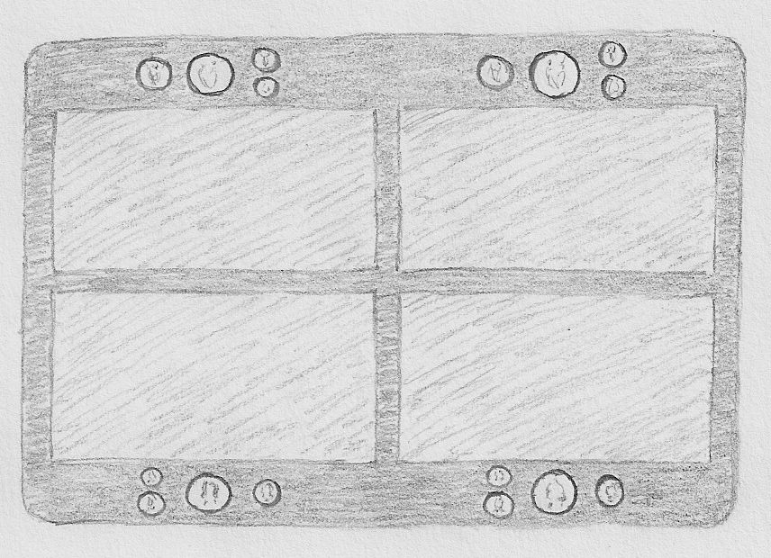
Ideas for the Display Unit
Use a single, flat table for the interactive unit.
Split the table into four separate displays, each with its own set of controls, so that up to four people can participate simultaneously.

Slide 5
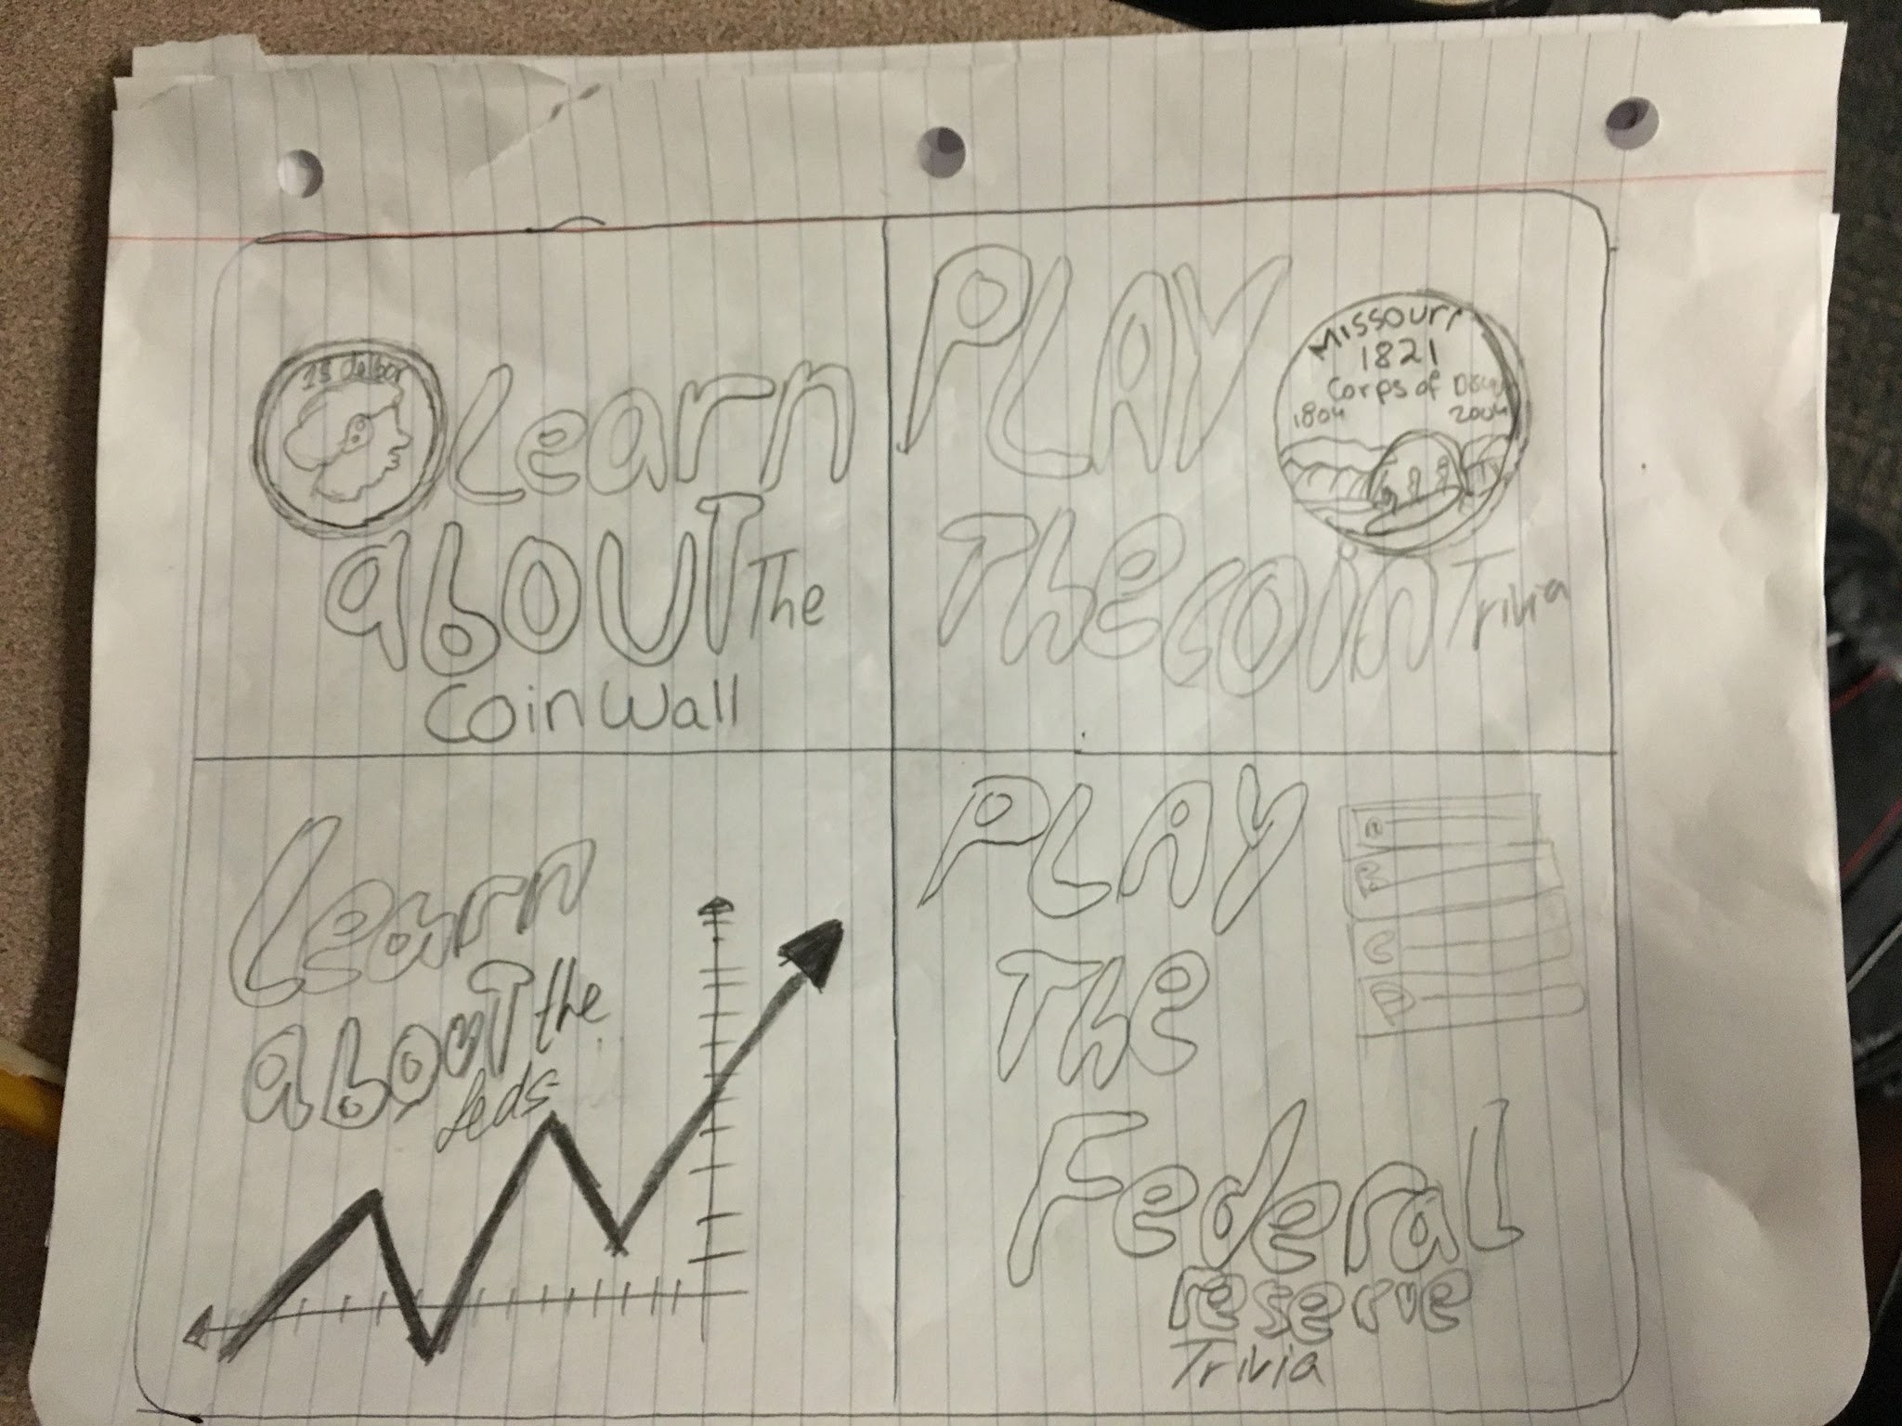
Early Prototype Screens
This is the first page/main menu.
It is separated into fours options.
Option 1 has information about the Coin wall; Option 2 is a trivia game based on Option 1.
Option 3 has information about the Federal Reserve. Option 4 is trivia about Option 3.

Slide 6
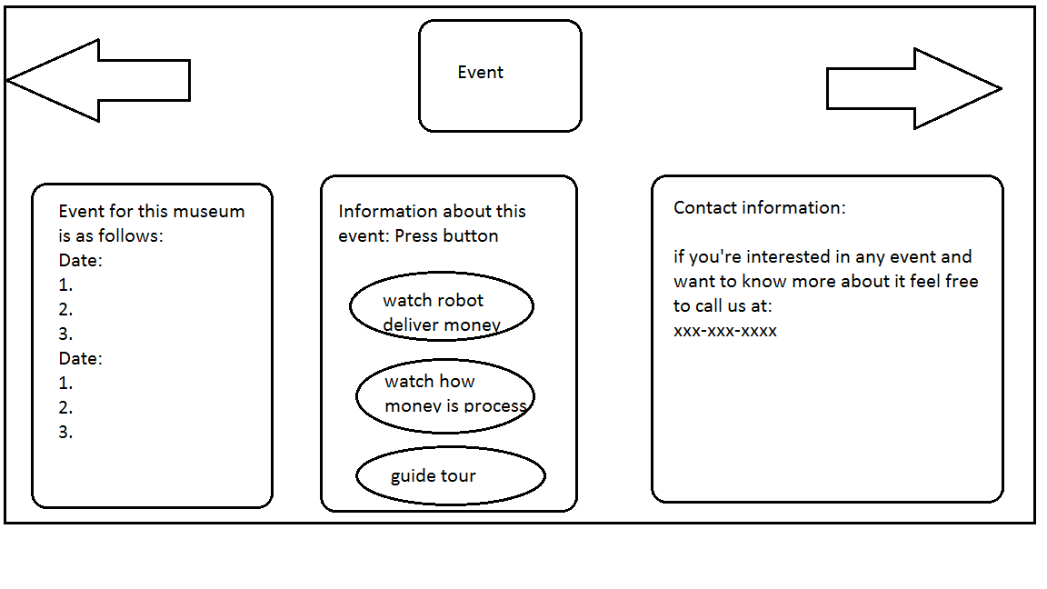
Early Prototype Screens
Events screen with “Back” and “Next” buttons
Shows event for this museum, the dates and name of the event
Buttons to click on information about the events
Contact information for anyone wanting to learn more about the events

Slide 7
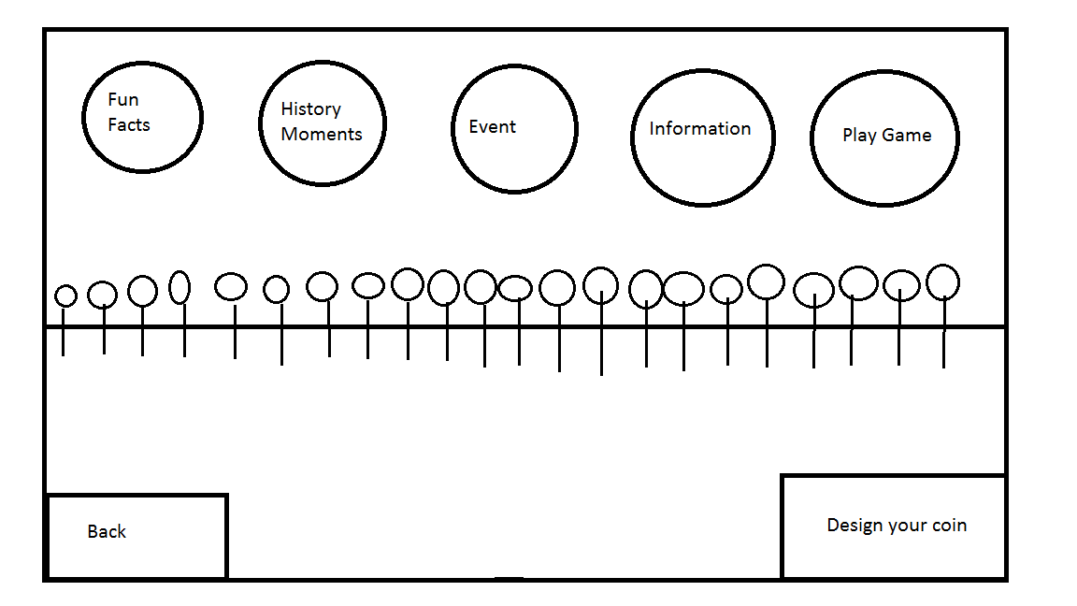
Early Prototype Screens
Idea for timeline
Fun Facts: Interesting and fun facts about each coin and its year
History Moments: Moments in the year that are memorable or a big event
Event: Event that’s available at the Federal Reserve Bank or another relevant source
Information: Information about the bank (“About” page), history of the Federal Reserve Bank
Play Game: Takes you to a game page
Design your coin: Design a coin, take picture of yourself and edit coin

Slide 8
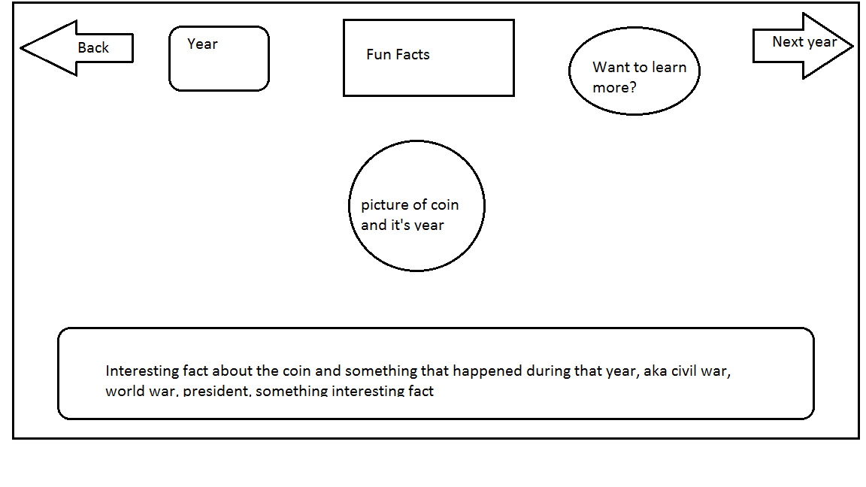
Early Prototype Screens
Fun Facts Page
Show year of the coin and a picture of the coin
Facts about this year
“Want to learn more?” button
Text box description
“Back” button will go back to the timeline to choose year of next coin, or one may press the “Next Year” button

Slide 9
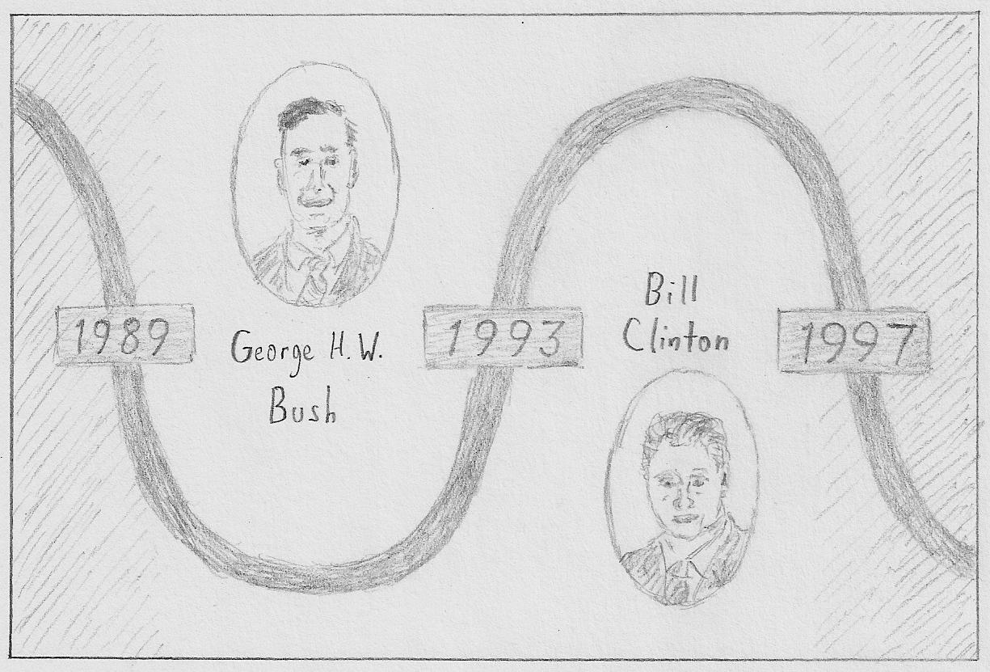
Early Prototype Screens
Timeline: Main Screen
Organize timeline information by Presidential terms
Focus on the center of the screen and gray out the left and right sides as the user scrolls through the timeline
Display a selection menu for a Presidential term when the user stops scrolling

Slide 10
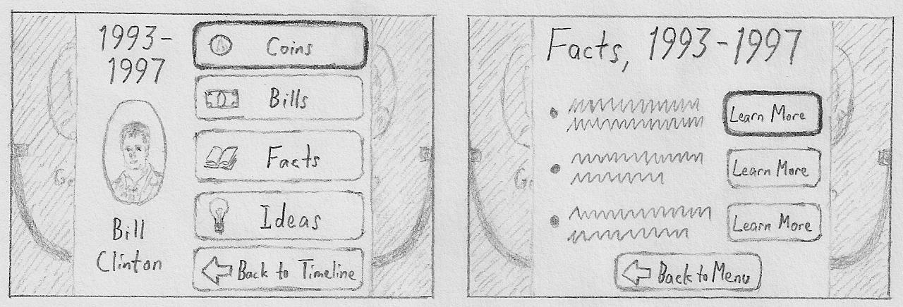
Early Prototype Screens
Timeline: Sub-Screens. These use nested levels of information, so participants can choose how much they want to learn. The timeline is shown in the background.

Slide 11
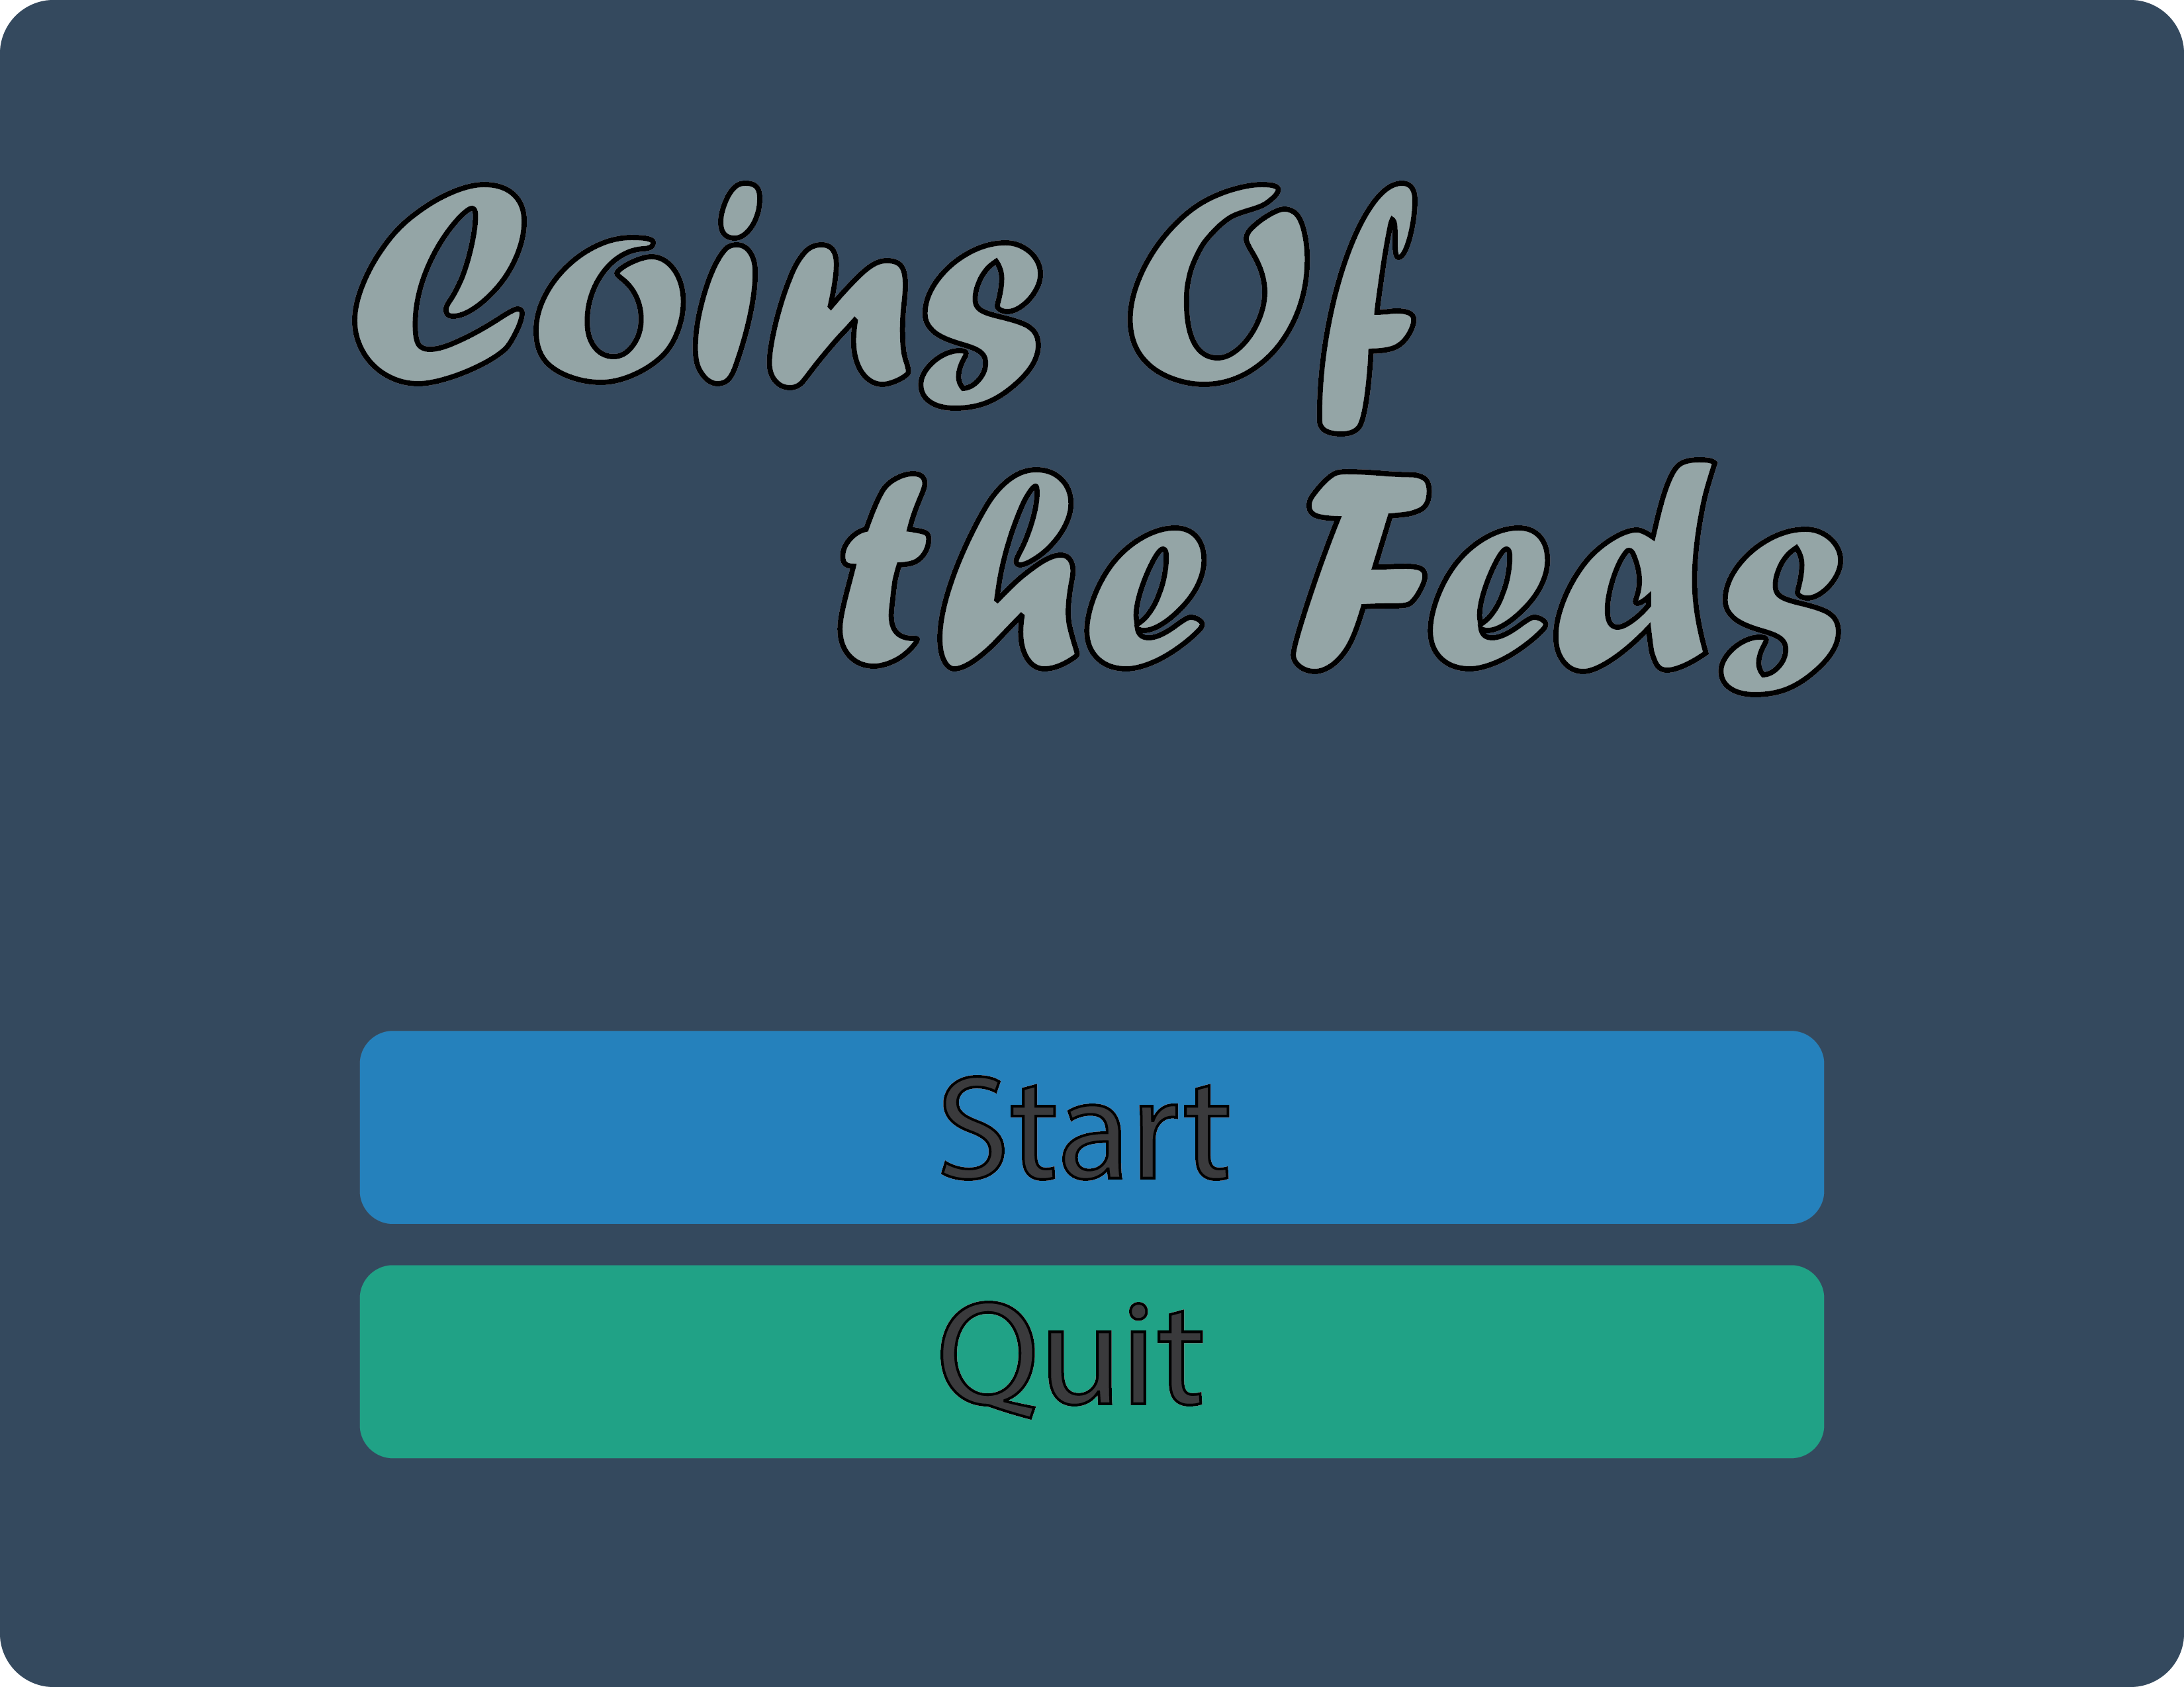
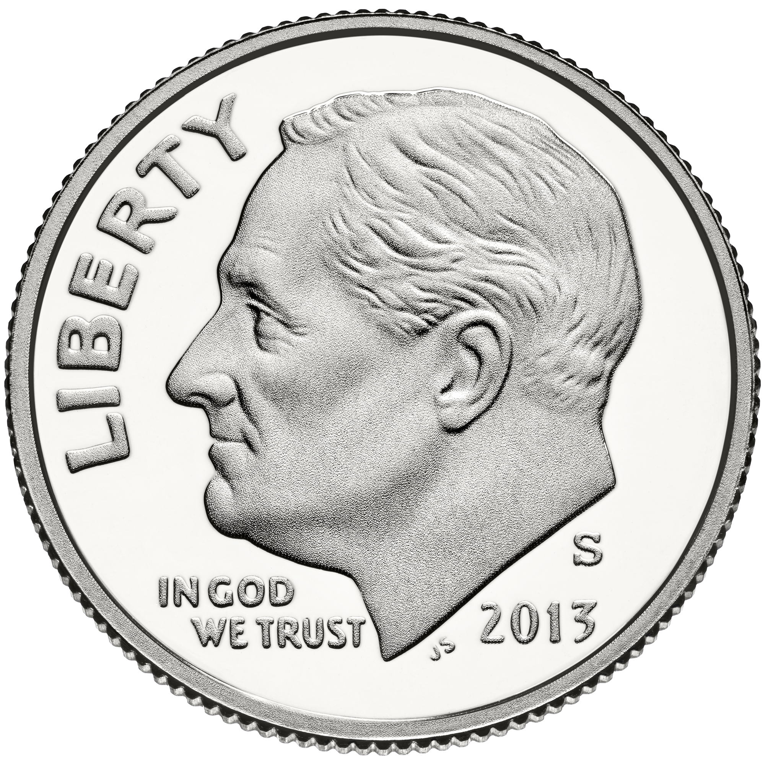
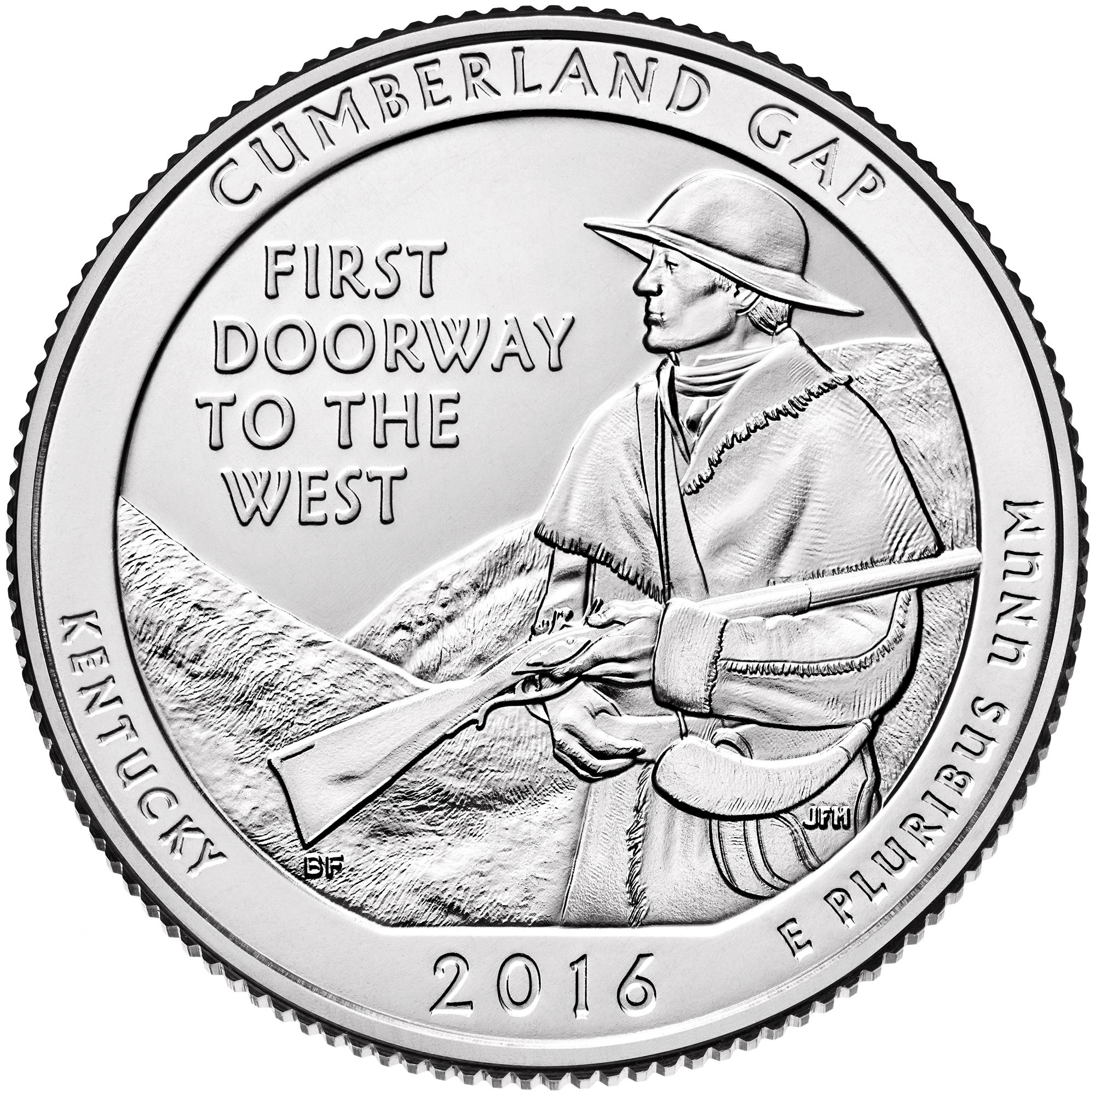
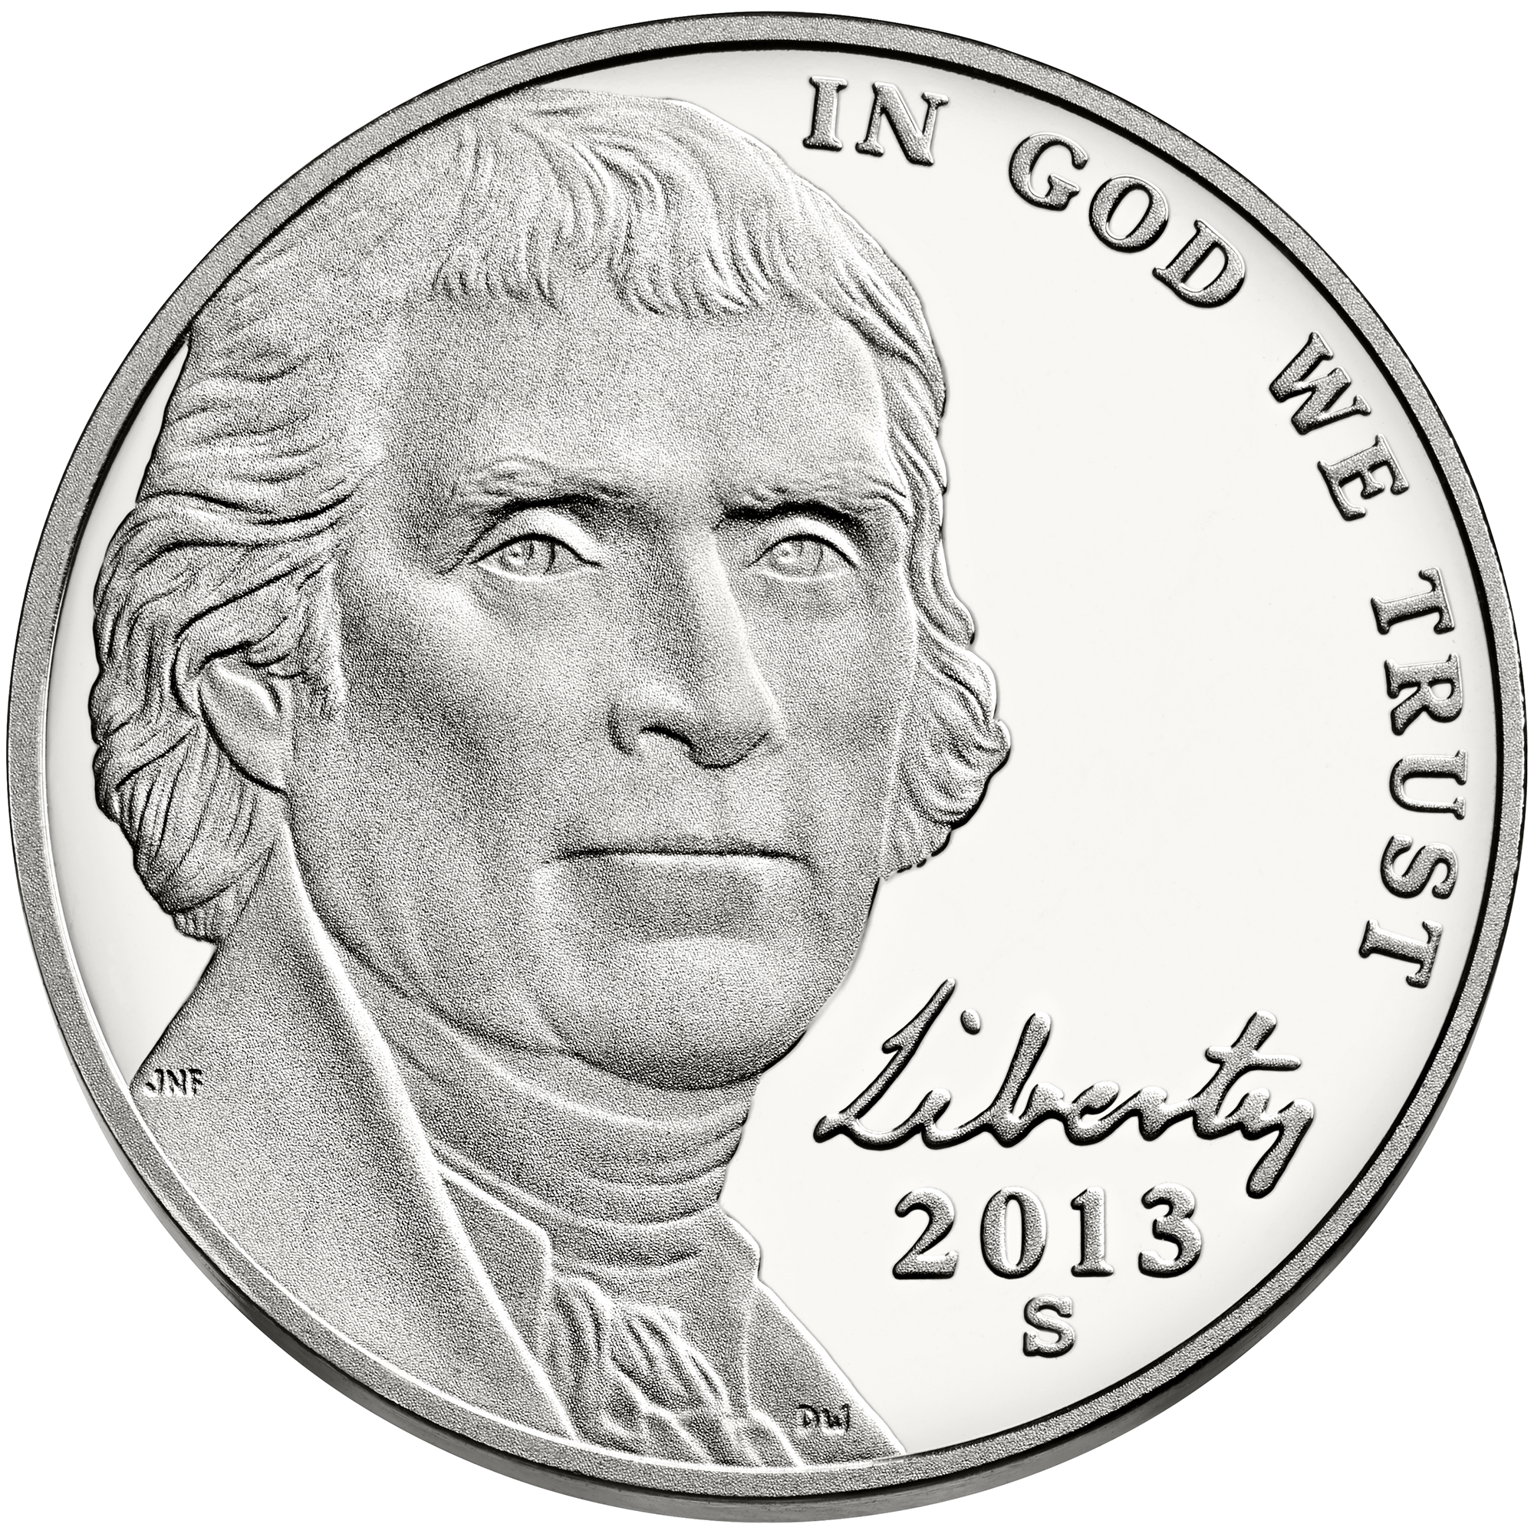
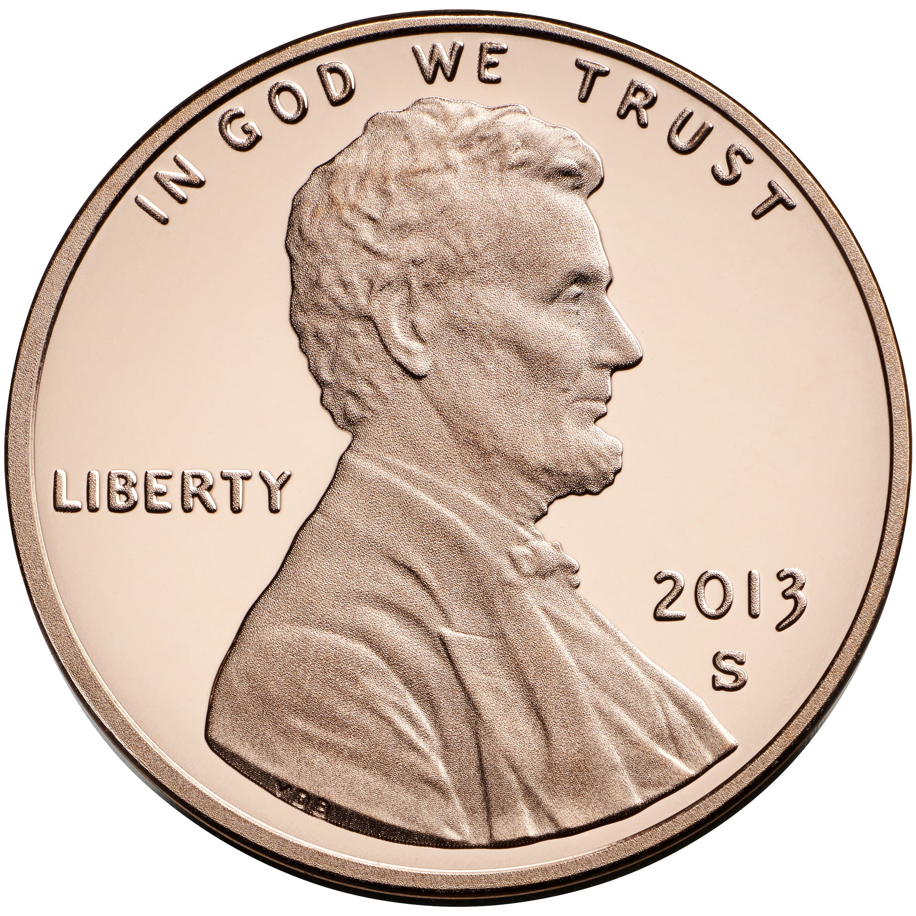
SELECT

Slide 12
SELECT

Slide 13
SELECT

Slide 14
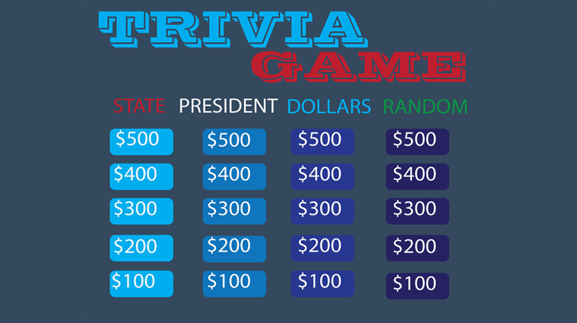
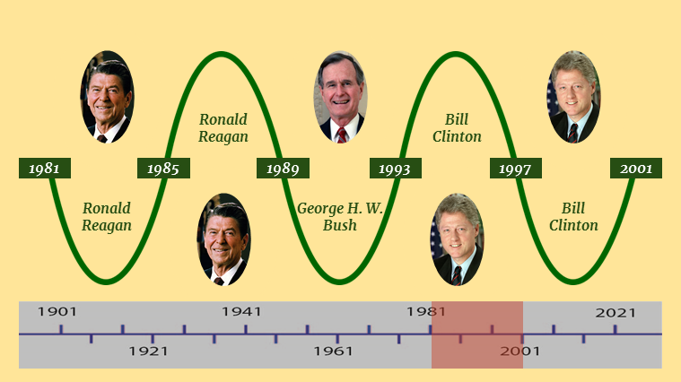
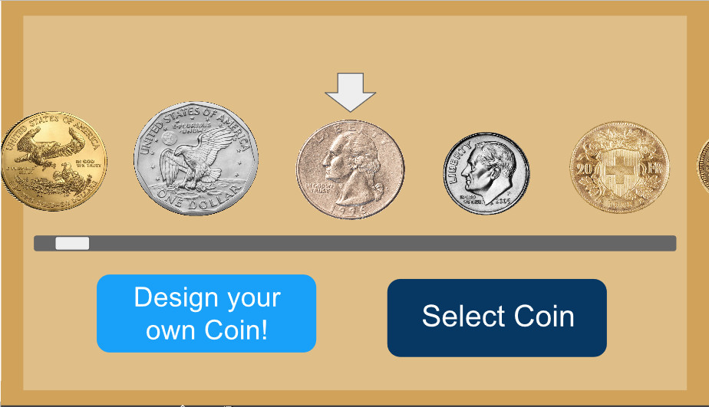
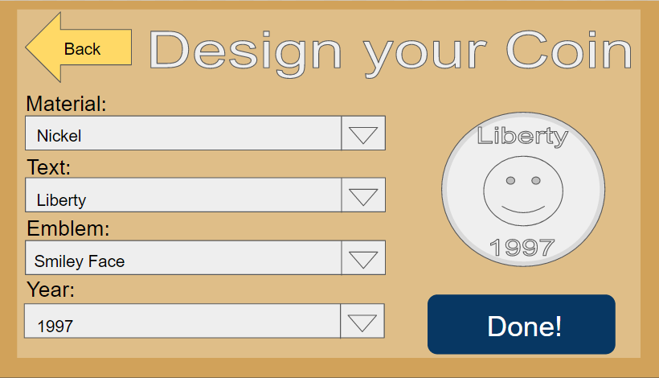
Coins of the Feds
Interactive Timeline
SELECT

Slide 15
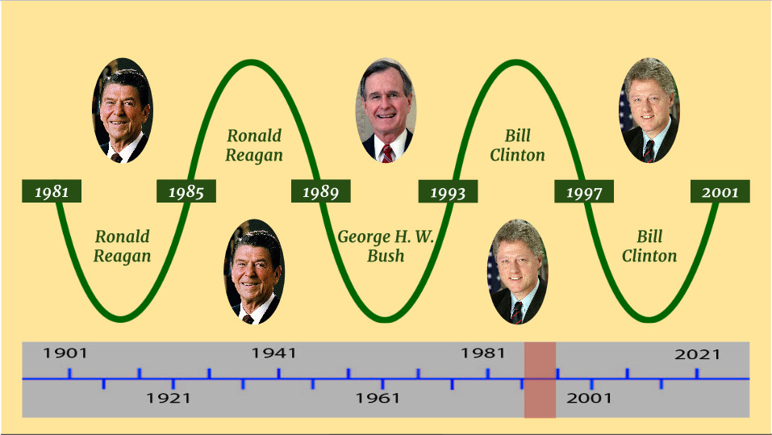
Coins of the Feds
Design Your Own Coin
SELECT

Slide 16
Coins of the Feds
Trivia Game
SELECT

Slide 17
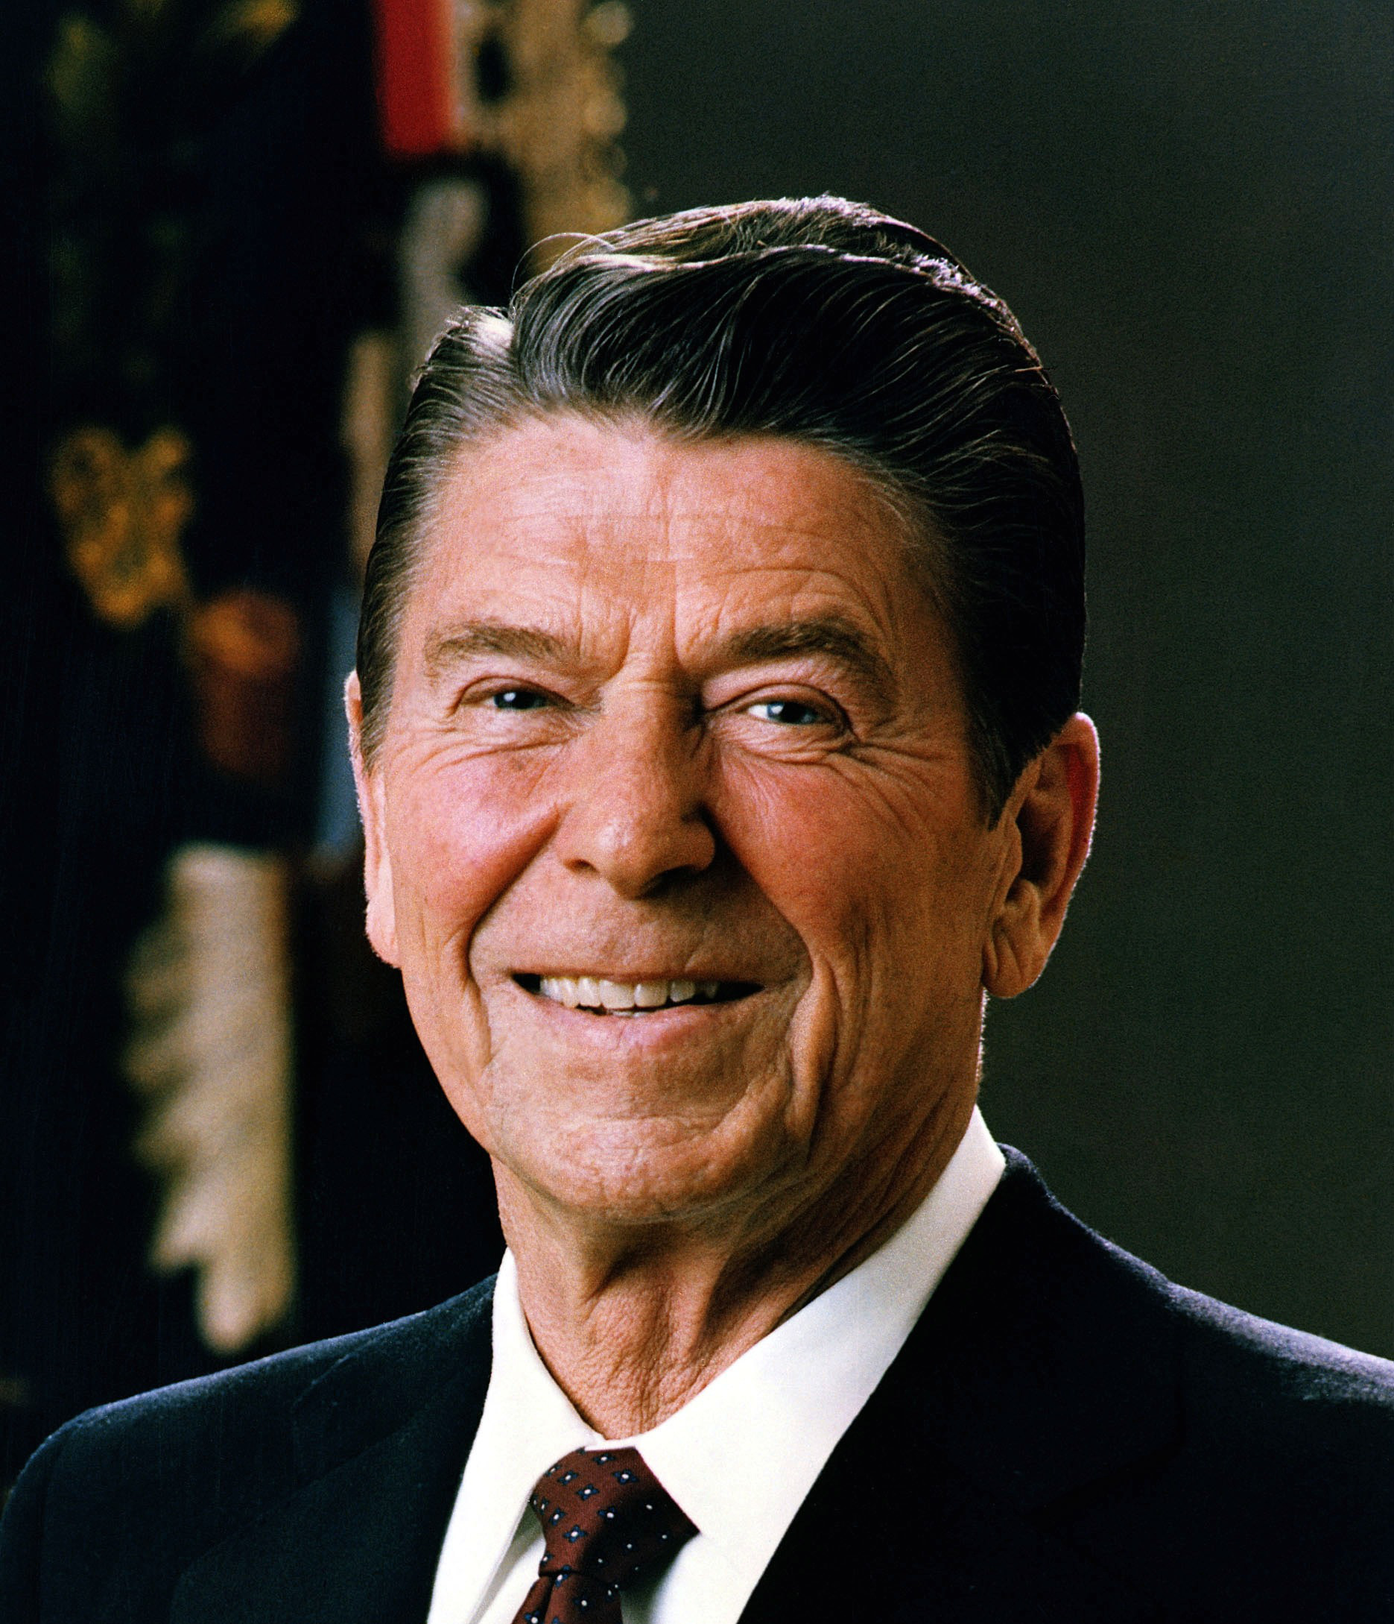
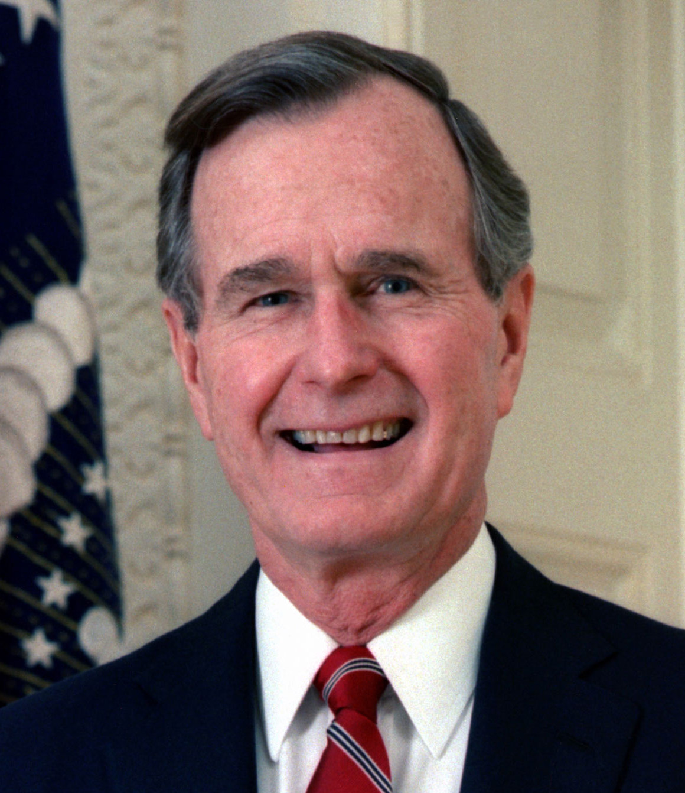
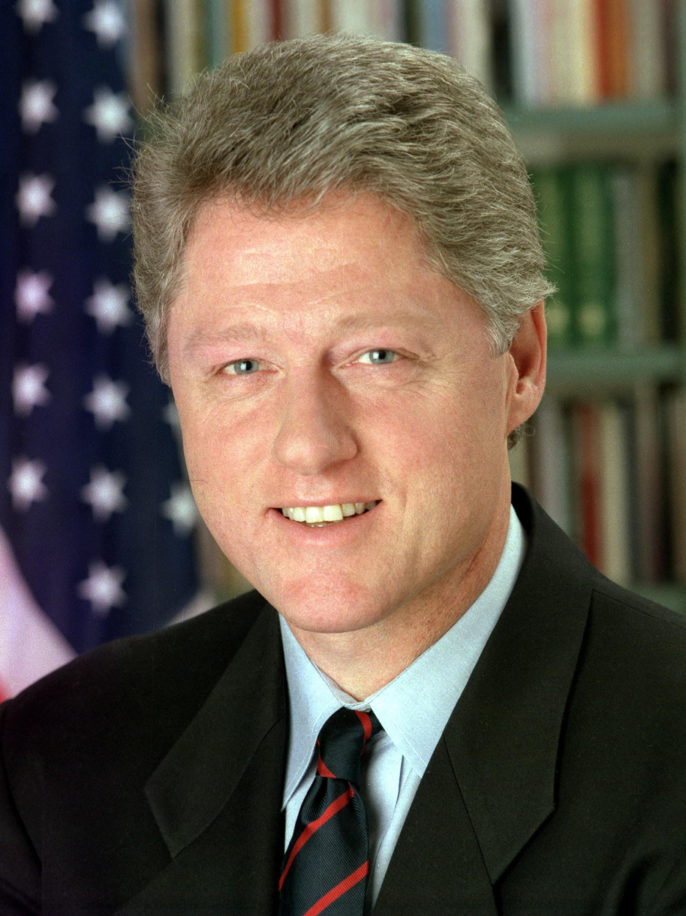
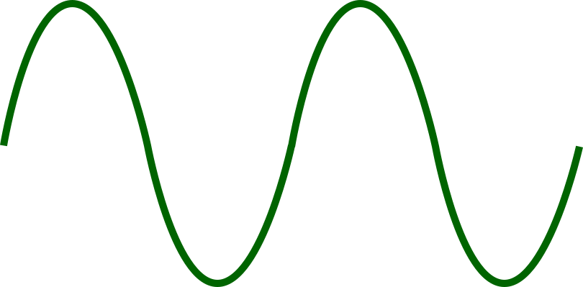
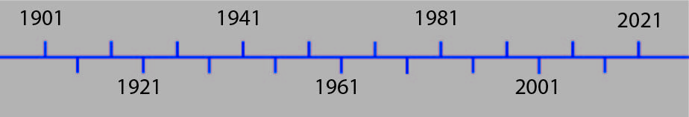
Quit
Ronald Reagan
Bill Clinton
1981
1985
1989
1993
1997
2001
Ronald Reagan
George H. W. Bush
Bill Clinton
SELECT
Notes:
As you can see here

Slide 18
Quit
Ronald Reagan
Bill Clinton
1981
1985
1989
1993
1997
2001
Ronald Reagan
George H. W. Bush
Bill Clinton
SELECT

Slide 19
Quit
Ronald Reagan
Bill Clinton
1981
1985
1989
1993
1997
2001
Ronald Reagan
George H. W. Bush
Bill Clinton
SELECT

Slide 20
Quit
Ronald Reagan
Bill Clinton
1981
1985
1989
1993
1997
2001
Ronald Reagan
George H. W. Bush
Bill Clinton
SELECT

Slide 21
Quit
Ronald Reagan
Bill Clinton
1981
1985
1989
1993
1997
2001
Ronald Reagan
George H. W. Bush
Bill Clinton
SELECT

Slide 22
Quit
Ronald Reagan
Bill Clinton
1981
1985
1989
1993
1997
2001
Ronald Reagan
George H. W. Bush
Bill Clinton
SELECT

Slide 23
Quit
Ronald Reagan
Bill Clinton
1981
1985
1989
1993
1997
2001
Ronald Reagan
George H. W. Bush
Bill Clinton
SELECT

Slide 24
Quit
Ronald Reagan
Bill Clinton
1981
1985
1989
1993
1997
2001
Ronald Reagan
George H. W. Bush
Bill Clinton
SELECT

Slide 25
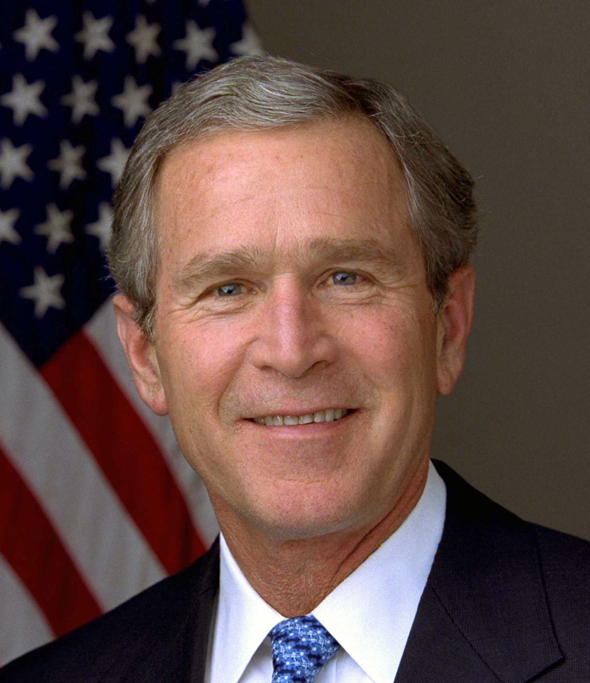
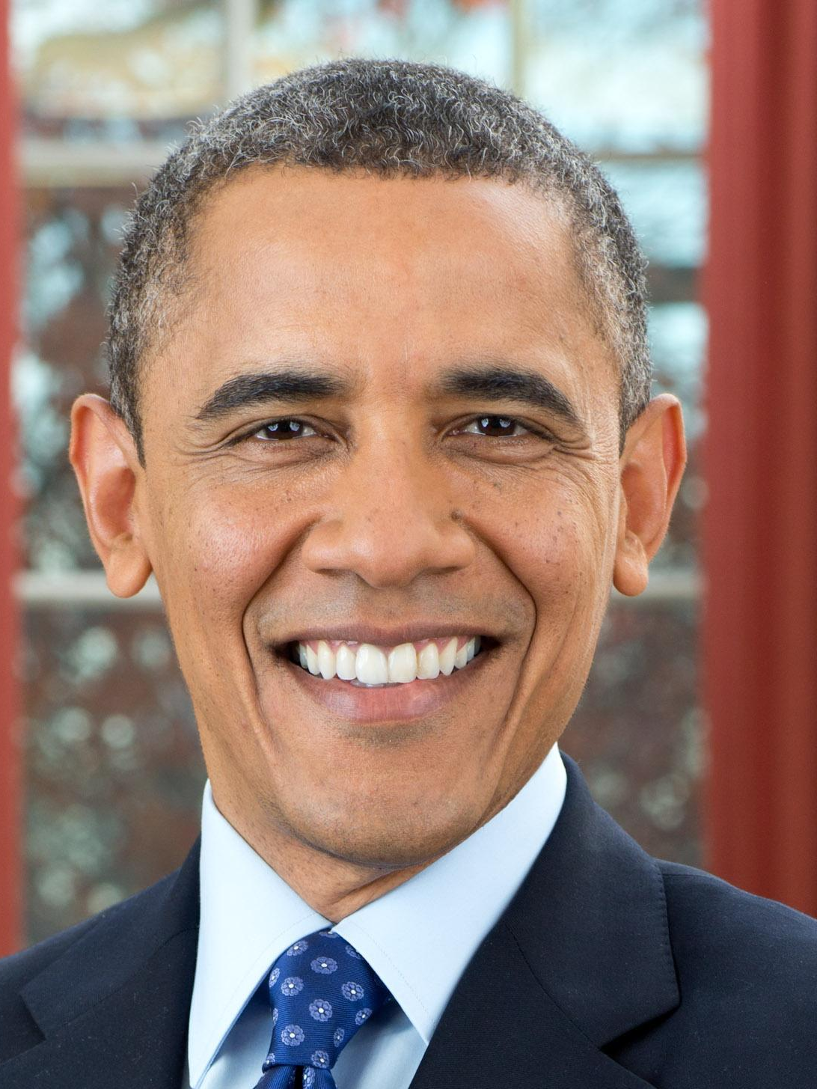
Quit
?
George W. Bush
Barack
Obama
2001
2005
2009
2013
2017
2021
George W.
Bush
Barack
Obama
???
SELECT

Slide 26
Quit
?
George W. Bush
Barack
Obama
2001
2005
2009
2013
2017
2021
George W.
Bush
Barack
Obama
???
SELECT

Slide 27
Quit
?
George W. Bush
Barack
Obama
2001
2005
2009
2013
2017
2021
George W.
Bush
Barack
Obama
???
SELECT

Slide 28
Quit
?
George W. Bush
Barack
Obama
2001
2005
2009
2013
2017
2021
George W.
Bush
Barack
Obama
???
SELECT

Slide 29
Quit
?
George W. Bush
Barack
Obama
2001
2005
2009
2013
2017
2021
George W.
Bush
Barack
Obama
???
SELECT

Slide 30
Quit
?
George W. Bush
Barack
Obama
2001
2005
2009
2013
2017
2021
George W.
Bush
Barack
Obama
???
SELECT

Slide 31
1993 -
1997
Coins
Bills
Ronald Reagan
Bill Clinton
1981
1985
1989
1993
1997
2001
!
Facts
Ronald Reagan
George H. W. Bush
Bill Clinton
?
Information
Bill Clinton
Back to Timeline
SELECT

Slide 32
1993 -
1997
Coins
Bills
Ronald Reagan
Bill Clinton
1981
1985
1989
1993
1997
2001
!
Facts
Ronald Reagan
George H. W. Bush
Bill Clinton
?
Information
Bill Clinton
Back to Timeline
SELECT

Slide 33
1993 -
1997
Coins
Bills
Ronald Reagan
Bill Clinton
1981
1985
1989
1993
1997
2001
!
Facts
Ronald Reagan
George H. W. Bush
Bill Clinton
?
Information
Bill Clinton
Back to Timeline
SELECT

Slide 34
1993 -
1997
Coins
Bills
Ronald Reagan
Bill Clinton
1981
1985
1989
1993
1997
2001
!
Facts
Ronald Reagan
George H. W. Bush
Bill Clinton
?
Information
Bill Clinton
Back to Timeline
SELECT

Slide 35
1993 -
1997
Coins
Bills
Ronald Reagan
Bill Clinton
1981
1985
1989
1993
1997
2001
!
Facts
Ronald Reagan
George H. W. Bush
Bill Clinton
?
Information
Bill Clinton
Back to Timeline
SELECT

Slide 36
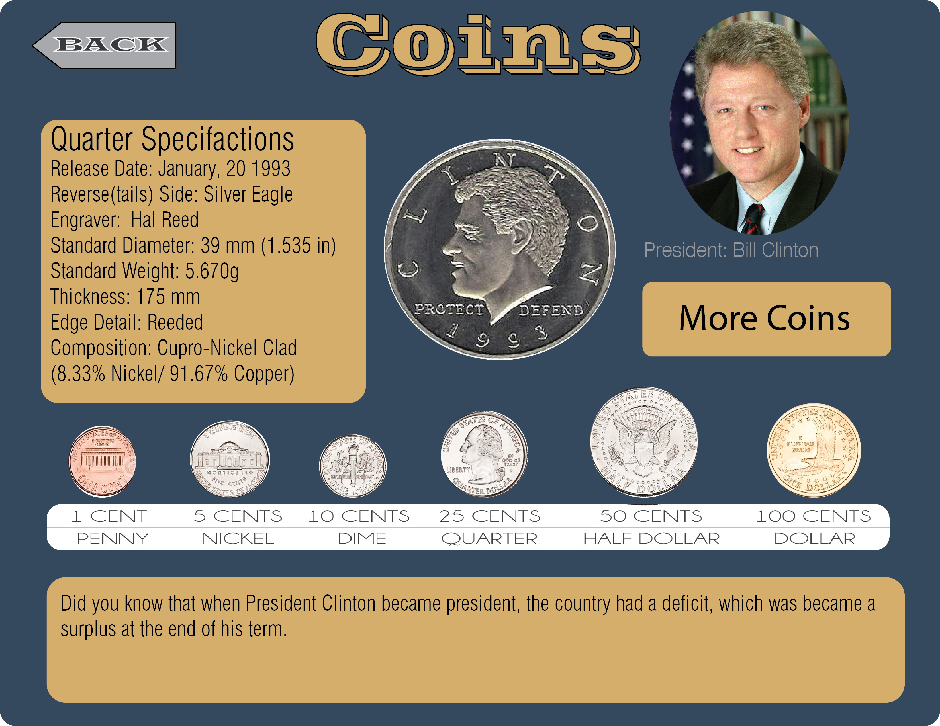
SELECT

Slide 37
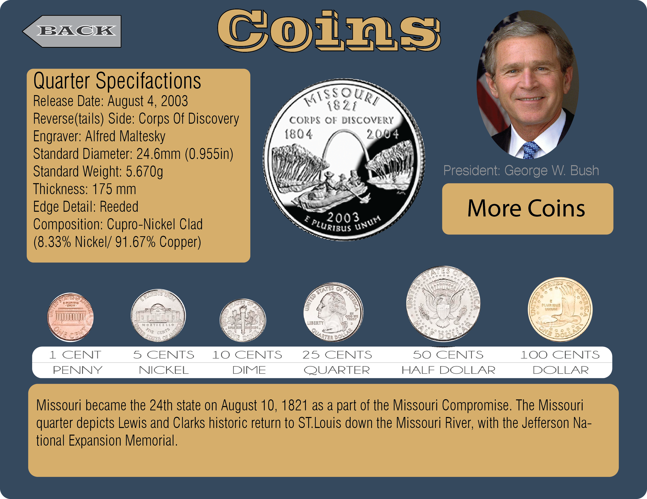
SELECT

Slide 38
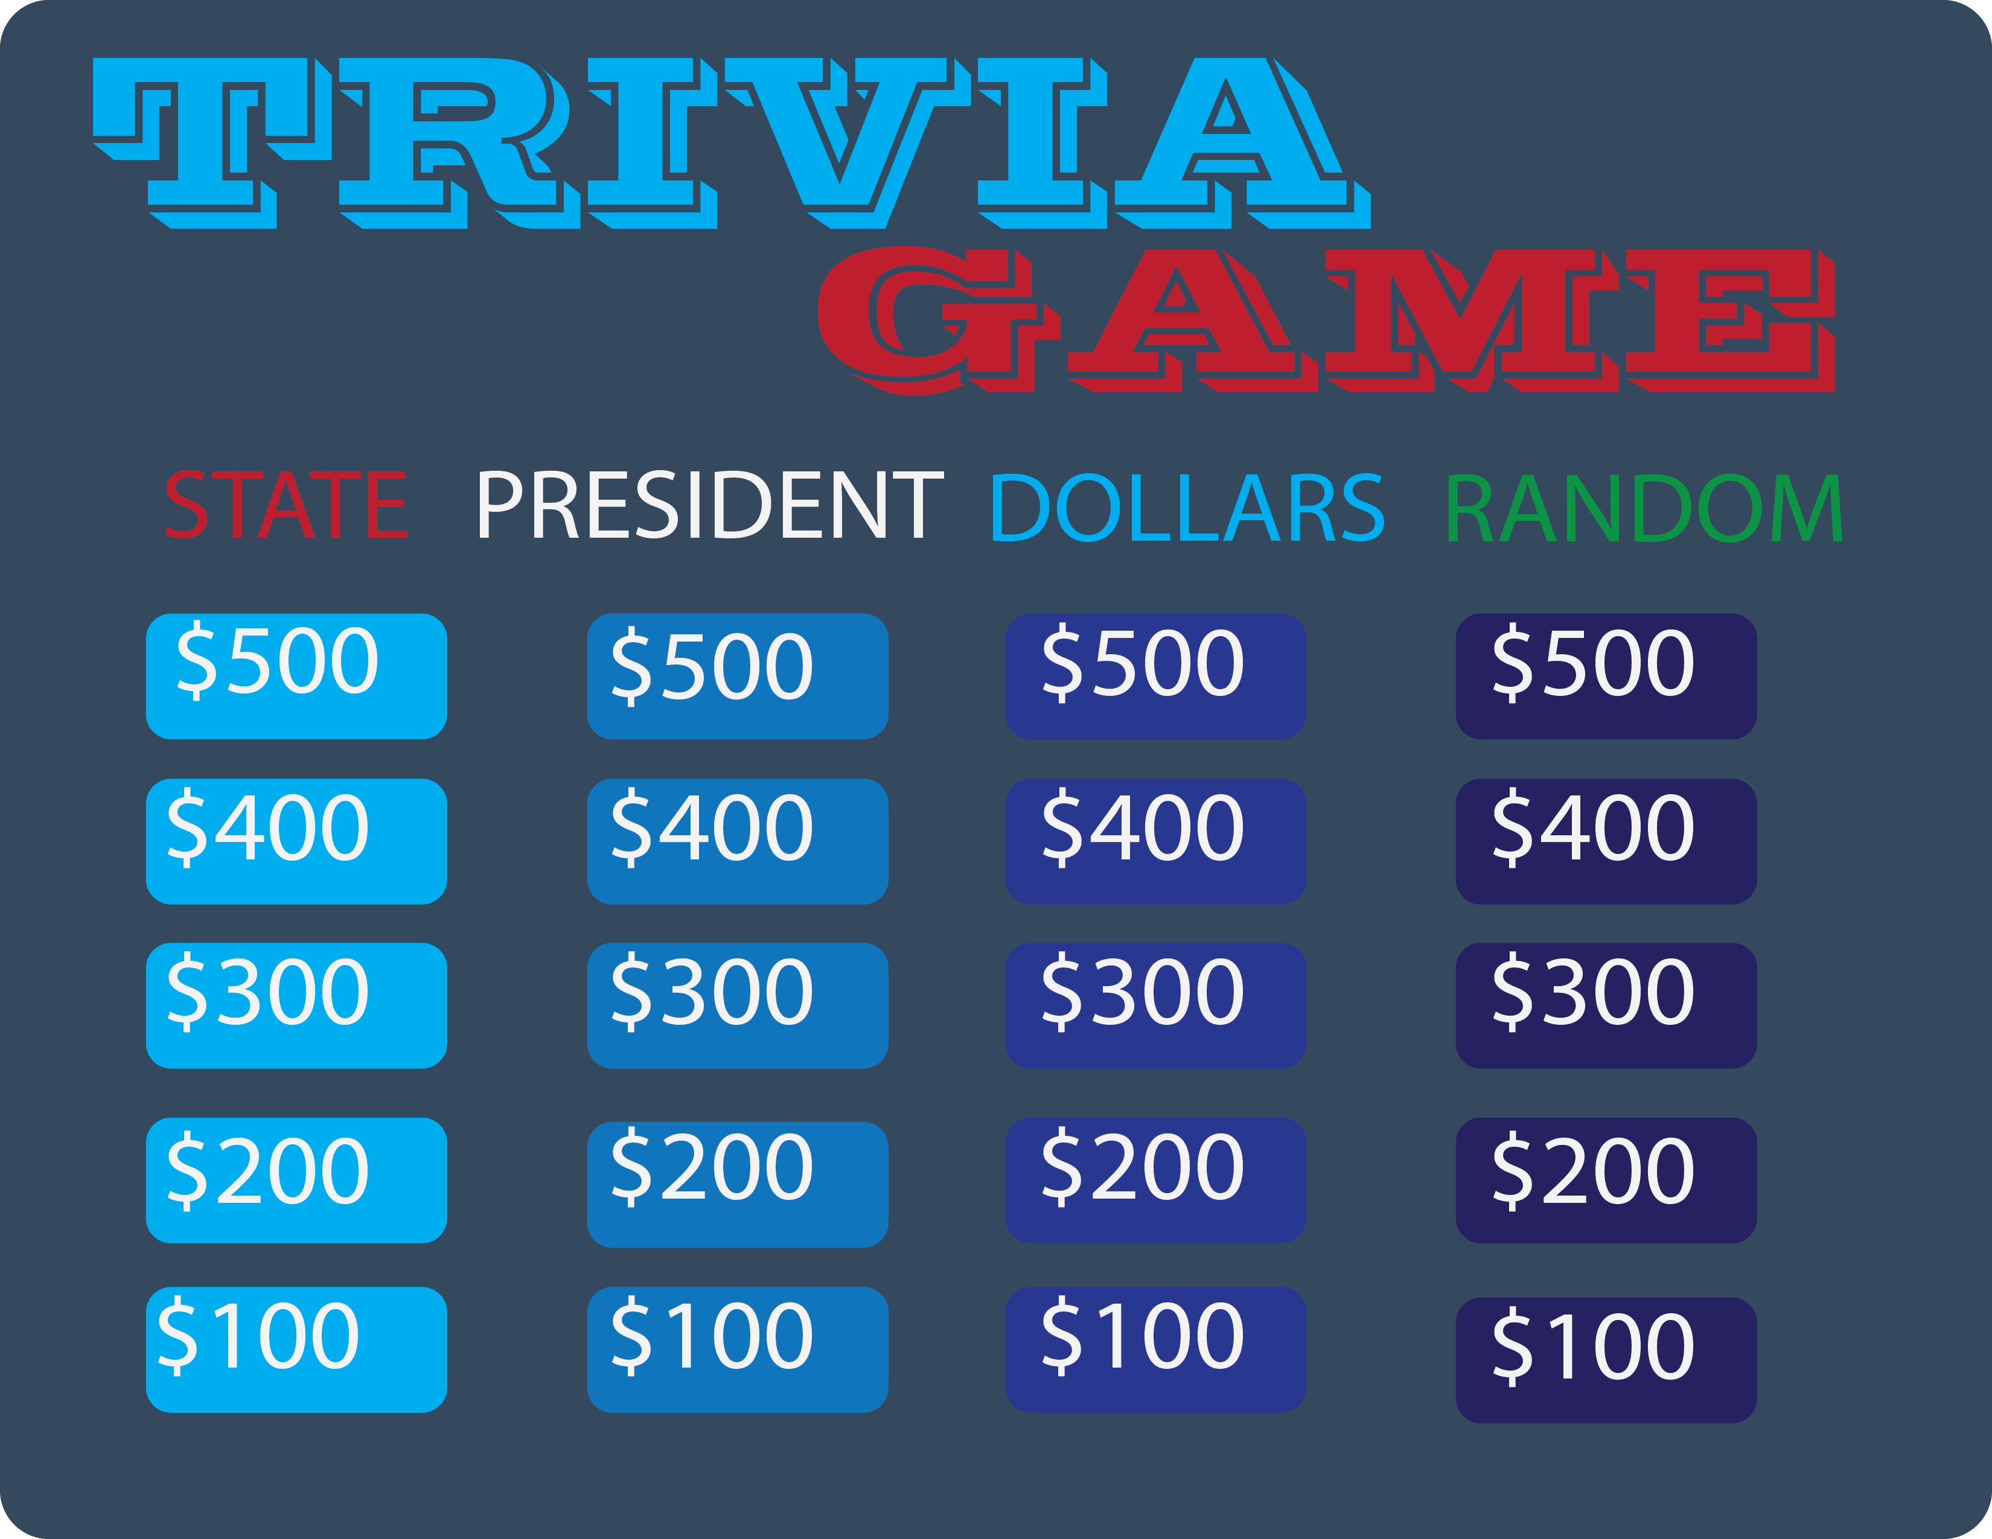
SELECT

Slide 39
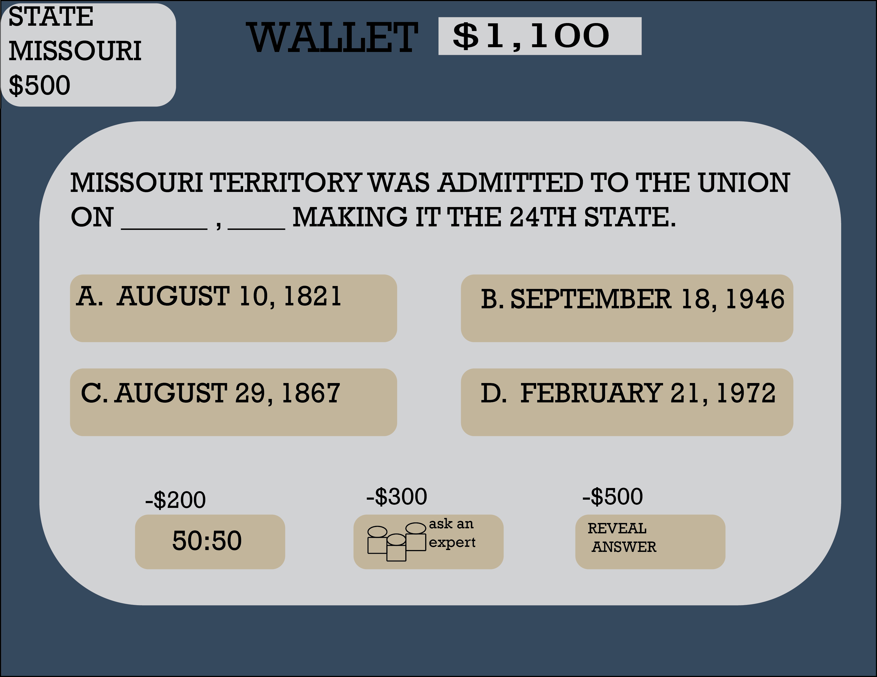
SELECT

Slide 40
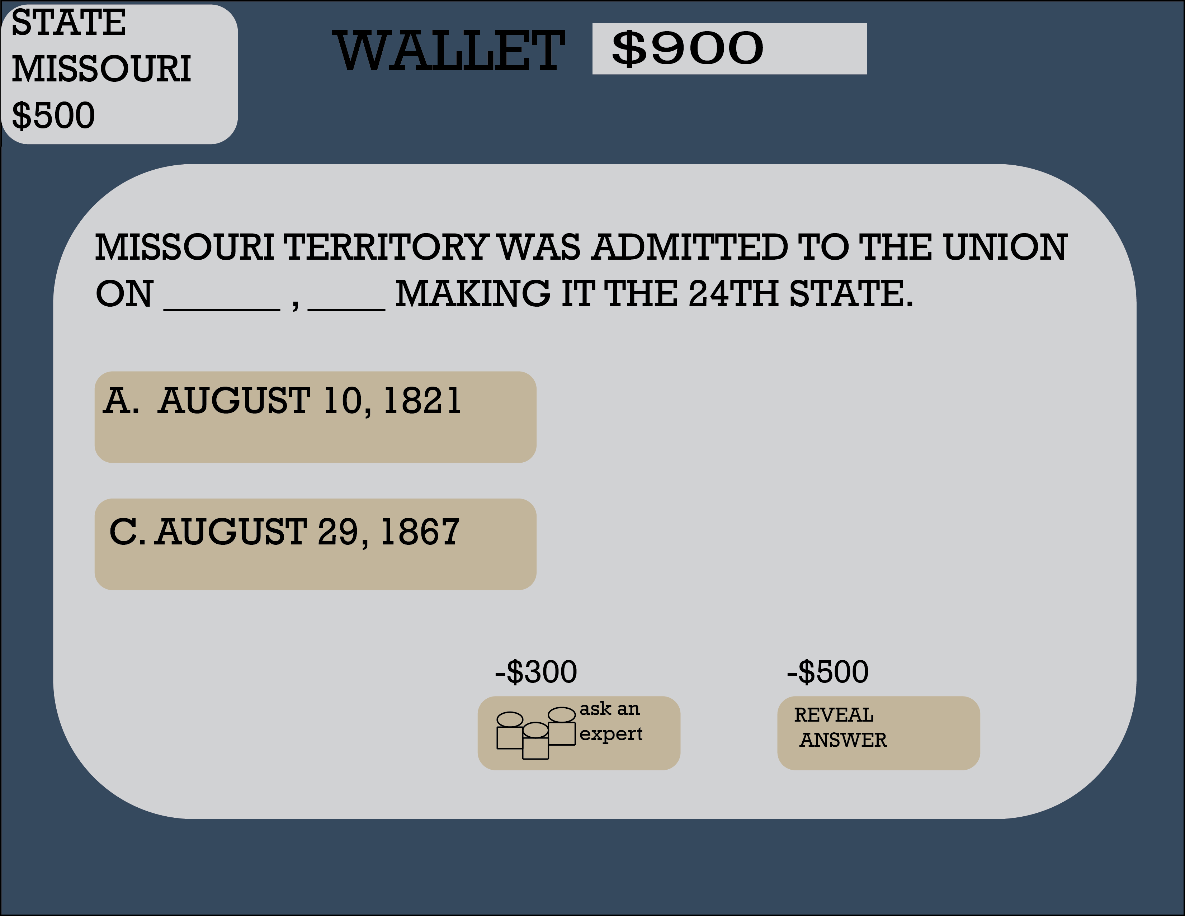
SELECT

Slide 41
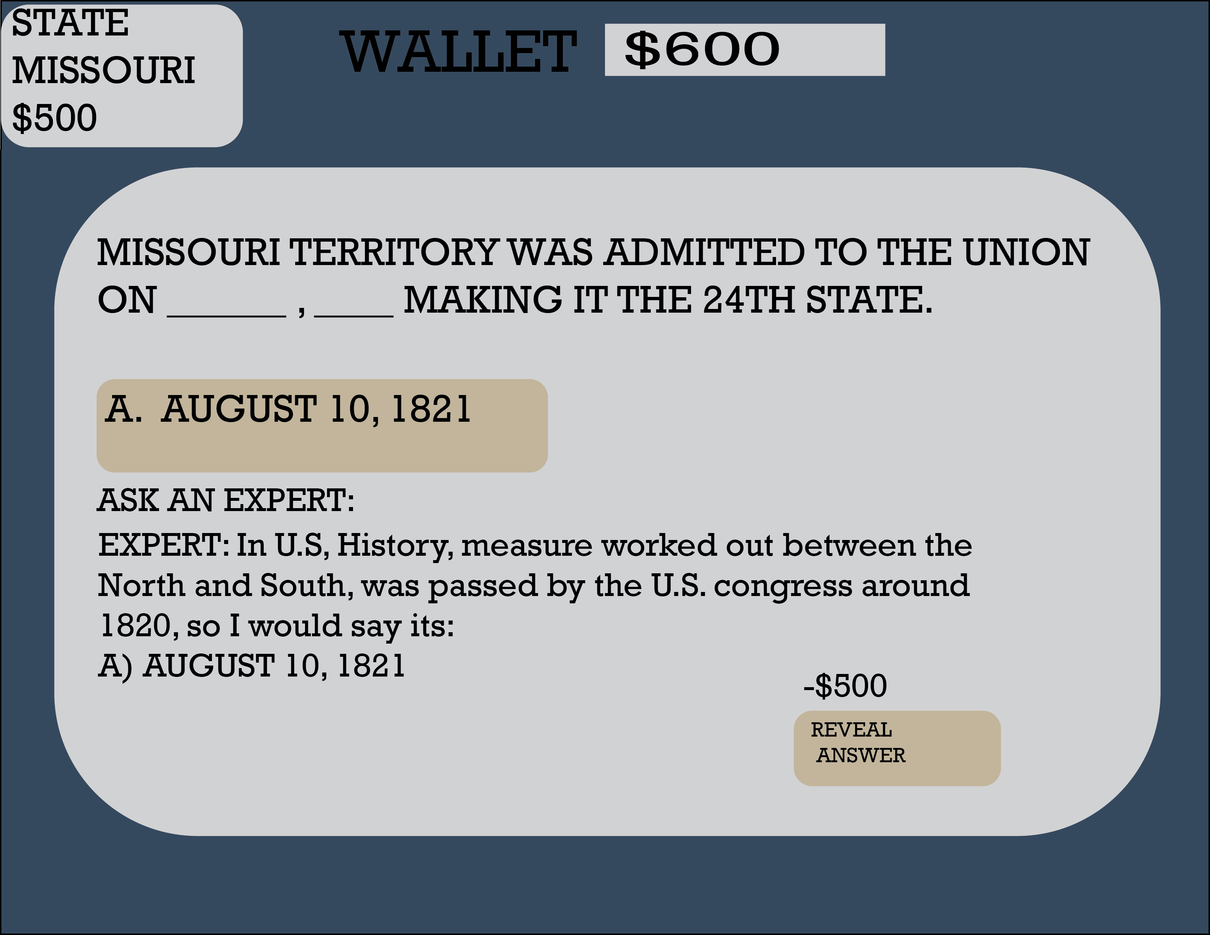
SELECT

Slide 42
SELECT

Slide 43
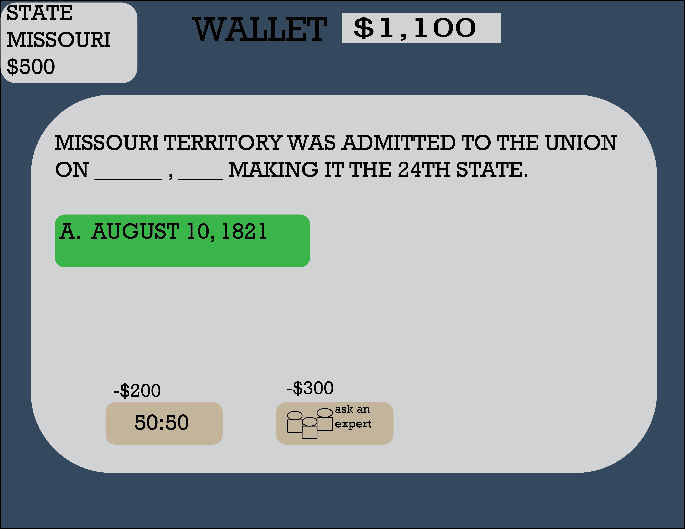
SELECT

Slide 44
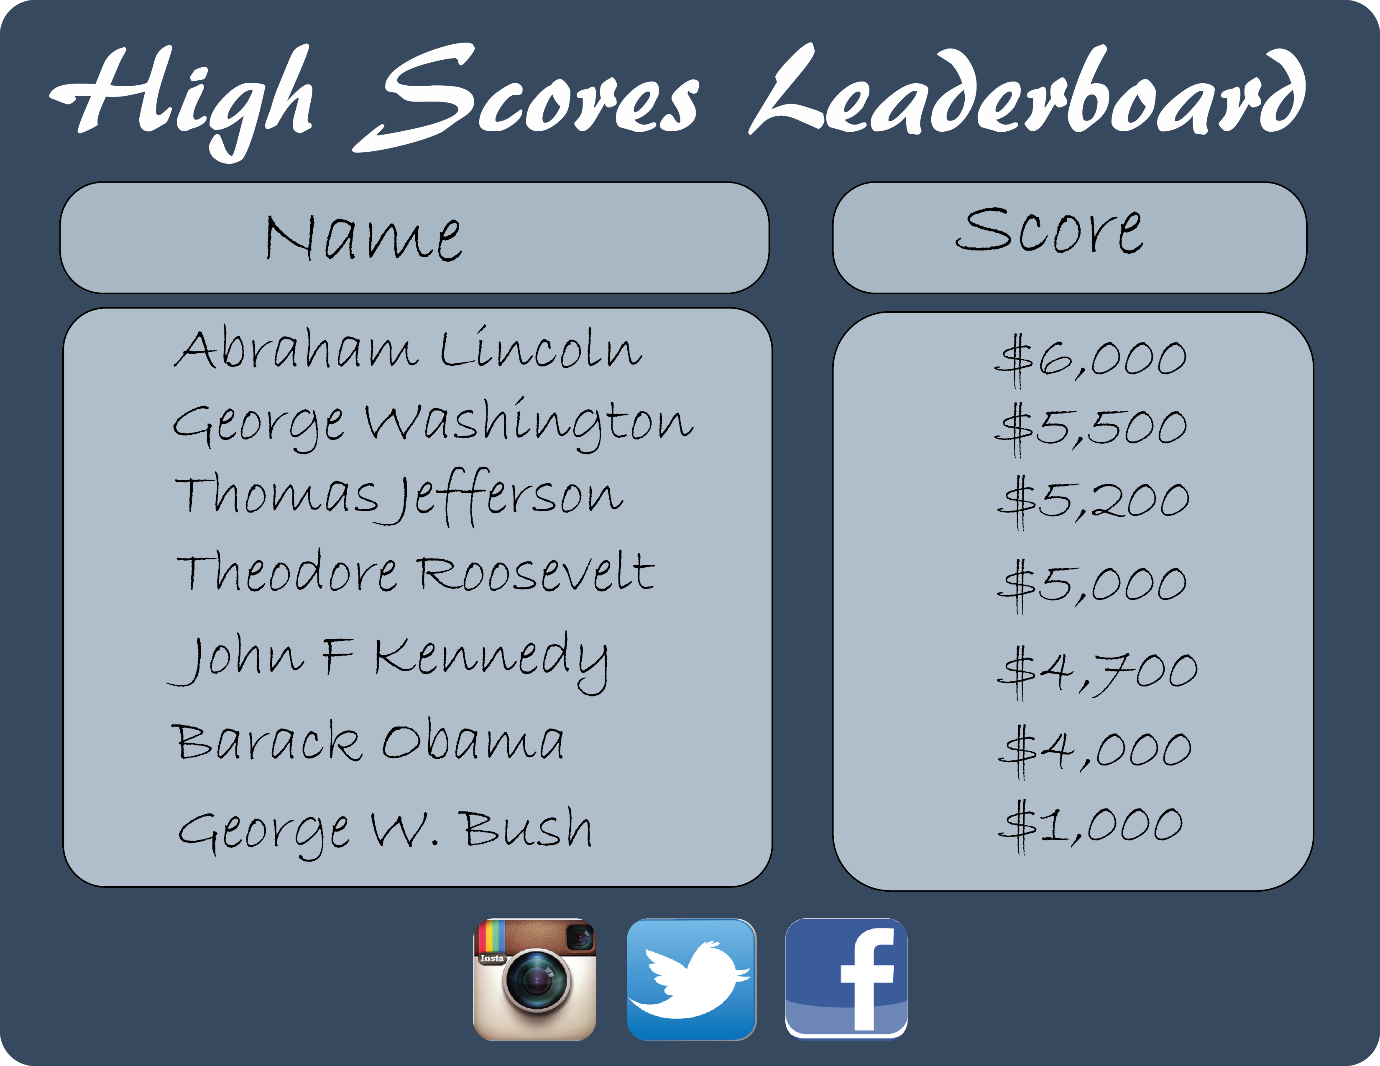
SELECT

Slide 45
References
The US50. “State of Missouri” The US50. The US50.com, 2016. Web. 22 April 2016. <http://www.theus50.com/missouri/quarter.php>. (About MO coin facts.)
"World Coin Gallery." World Coin Gallery. Web. 23 Apr. 2016. <http://worldcoingallery.com/>.

Slide 46
References (Continued)
Images:
Draper, Eric. “Official photograph portrait of former U.S. President George W. Bush.” Photograph. Wikipedia, The Free Encyclopedia. Wikipedia, The Free Encyclopedia, Posted 29 Nov. 2011, Created 14 Jan. 2003. Web. 22 April 2016. <https://en.wikipedia.org/wiki/George_W._Bush#/media/File:George-W-Bush.jpeg>.
McNeely, Bob. “Official White House photo of President Bill Clinton, President of the United States.” Photograph. Wikipedia, The Free Encyclopedia. Wikipedia, The Free Encyclopedia, Posted 29 Nov. 2007, Created in 1993. Web. 22 April 2016. <https://en.wikipedia.org/wiki/Bill_Clinton#/media/File:44_Bill_Clinton_3x4.jpg>.
“Official Portrait of George H. W. Bush, former President of the United States of America.” Photograph. Wikipedia, The Free Encyclopedia. Wikipedia, The Free Encyclopedia, Posted 24 May 2006, Created circa 1989. Web. 22 April 2016. <https://en.wikipedia.org/wiki/George_H._W._Bush#/media/File:George_H._W._Bush,_President_of_the_United_States,_1989_official_portrait.jpg>.
“Official Portrait of President Ronald Reagan.” Photograph. Wikipedia, The Free Encyclopedia. Wikipedia, The Free Encyclopedia, Posted 6 Sept. 2012, Created in 1981 or 1983, according to web page. Web. 22 April 2016. <https://en.wikipedia.org/wiki/Ronald_Reagan#/media/File:Official_Portrait_of_President_Reagan_1981.jpg>.
Souza, Pete. “U.S. President Barack Obama during a presidential portrait sitting for an official photograph in the Oval Office on 6 December 2012.” Photograph. Wikipedia, The Free Encyclopedia. Wikipedia, The Free Encyclopedia, Posted 18 Jan. 2013, Created 6 Dec. 2012. Web. 22 April 2016. <https://en.wikipedia.org/wiki/Barack_Obama#/media/File:President_Barack_Obama.jpg>.

Slide 47
References (Continued)
Images (Continued):
United States Mint. “A 2013 one-cent coin from the United States, known colloquially as a ‘penny’.” Digital image. Wikipedia, The Free Encyclopedia. Wikipedia, The Free Encyclopedia, 10 Feb. 2014. Web. 22 April 2016. <https://en.wikipedia.org/wiki/Penny#/media/File:US_One_Cent_Obv.png>.
United States Mint. “United States Dime obverse.” Digital image. Wikipedia, The Free Encyclopedia. Wikipedia, The Free Encyclopedia, 10 Feb. 2014. Web. 22 April 2016. <https://en.wikipedia.org/wiki/Dime_%28United_States_coin%29#/media/File:Dime_Obverse_13.png>.
United States Mint. “United States Five Cents Obverse.” Digital image. Wikipedia, The Free Encyclopedia. Wikipedia, The Free Encyclopedia, 10 Feb. 2014. Web. 22 April 2016. <https://en.wikipedia.org/wiki/Nickel_%28United_States_coin%29#/media/File:US_Nickel_2013_Obv.png>.
United States Mint. “U.S. quarter dollar coin in the collection ‘America the Beautiful quarters’, struck in 2016 for the Cumberland Gap National Historical Park.” Digital image. Wikipedia, The Free Encyclopedia. Wikipedia, The Free Encyclopedia, 14 Nov. 2013. Web. 22 April 2016. <https://en.wikipedia.org/wiki/Quarter_%28United_States_coin%29#/media/File:US_coin_25c_2016_ATB_Cumberland.jpg>.
United States Mint. “The American Gold Eagle”” Digital image. Wikipedia, The Free Encyclopedia. Wikipedia, The Free Encyclopedia, 14 Nov. 2013. Web. 22 April 2016. <https://en.wikipedia.org/wiki/American_gold_eagle#/media/File:Liberty_$50_Reverse.png>.

